Slide 1

Machine Learning for Cyber Security
Week 8
Mesut GUVEN, Ph.D.

Slide 2
information
Exams; 55% (Mid 25% + Final 30%), Homeworks; 15%, Project; 30%
In homeworks, you will be expected to examine SCI/E papers (published in last 3 years).
In Final Project, you will implement an AI/ML-based cyber solution.
Textbook:
- Getting Started with Deep Learning: Programming and Methodologies using Python
- Hands-On Machine Learning with Scikit-Learn, Keras, and TensorFlow, 2nd Edition
Code: GitHub
Videos: YouTube

Slide 3
UNIT 8: transfer learning
Learning Outcomes;
- have a better understanding of pre-trained models,
- have a better understanding of usage of pre-trained models in cyber,

Slide 4
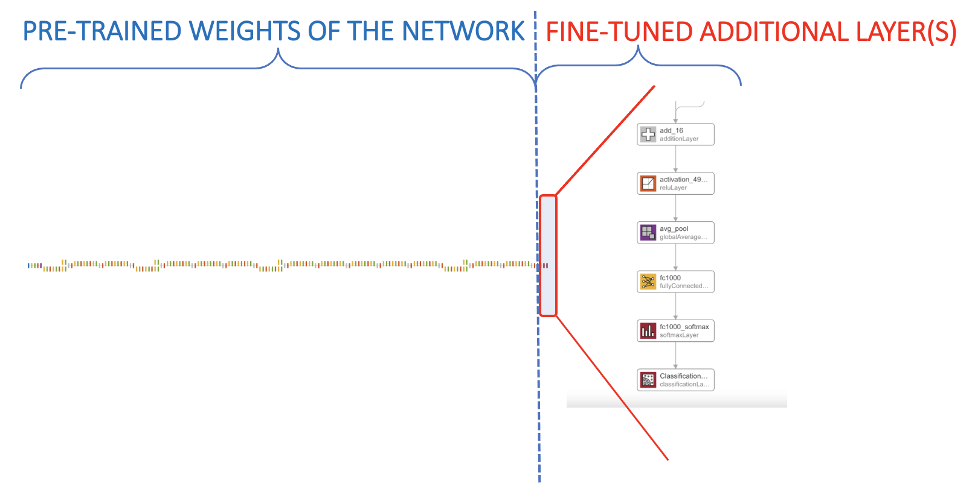
Transfer learning
Transfer learning is a technique that reuses a model which has already been trained on a large dataset.
If you want to build an image classifier, but you do not have enough training data, then it is often a good idea to reuse the lower layers of a pretrained model.

Slide 5
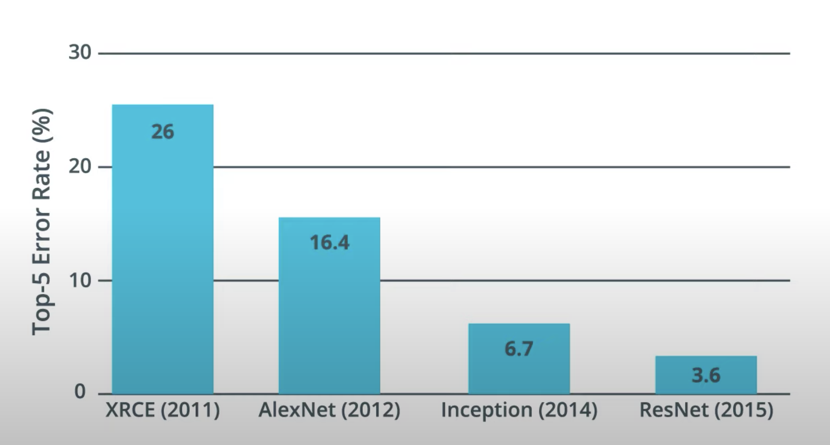
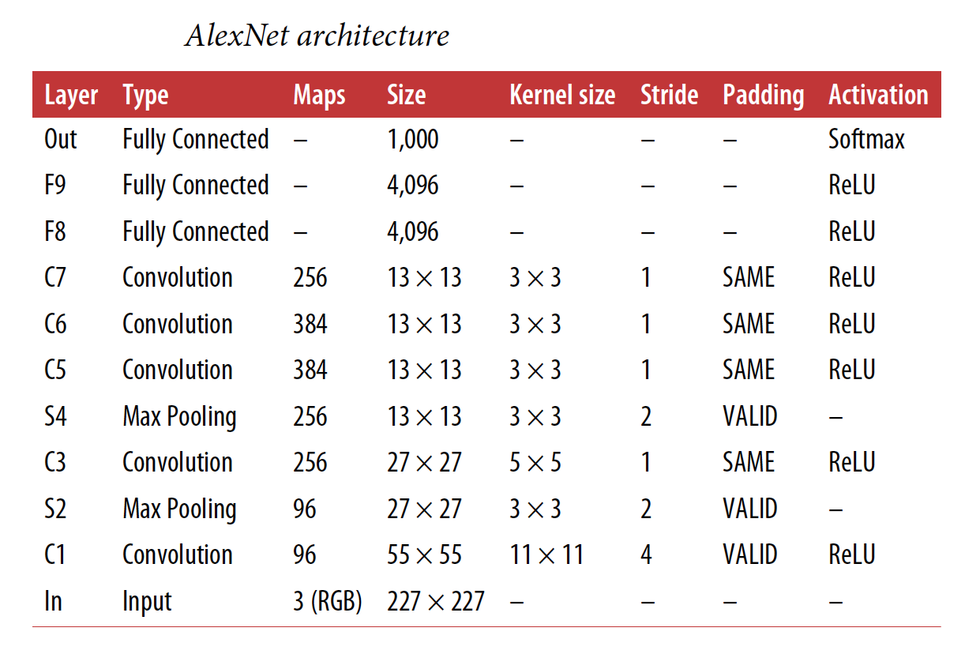
Transfer learning
Over the years, variants of DL models and CNN architecture have been developed. They proved their efficiency with largest image data set (ImageNet).
In competitions such as the ILSVRC ImageNet challenge. In this competition the top-5 error rate for image classification fell from over 26% to less than 2.3% in just six years.
TensorFlow Transfer Learning Repository (as well as Matlab) enables to use pre-trained models. Some of the most popular nets are respectively, GoogLeNet, ResNet, ImageNet, Inception, Exception, Bert, etc.

Slide 6
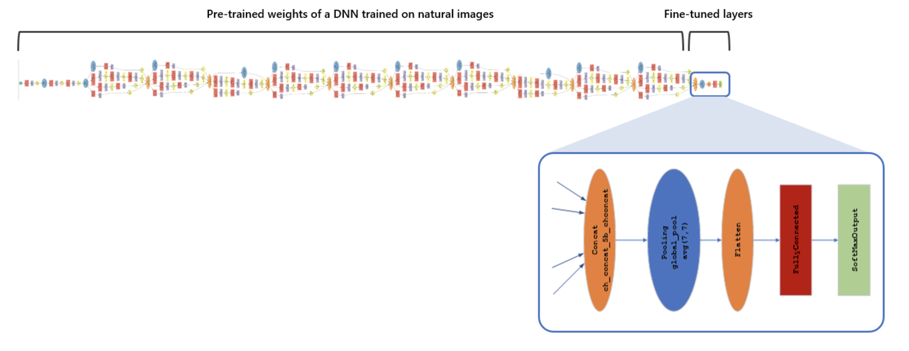
Transfer learning
The idea behind transfer learning is that a model trained on a large dataset can be applied to a dataset it has never seen before.
To implement transfer learning, output layer is replaced with a new layer and trained again (without changing weight and bias values of the rest of the network).
Since other variables are kept same with the pre-trained model, transfer learning also reduces the training time.

Slide 7
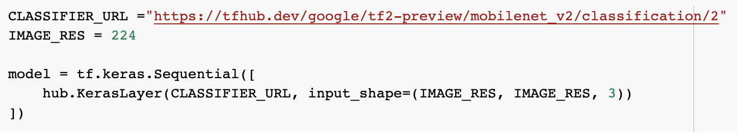
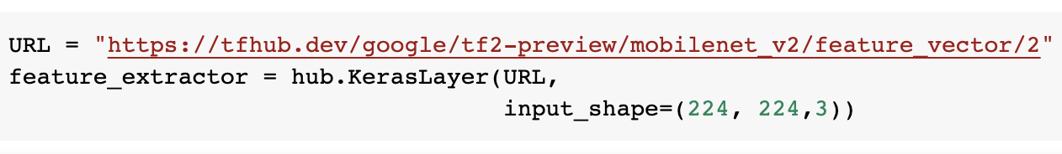
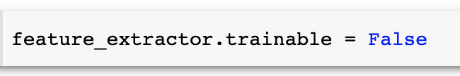
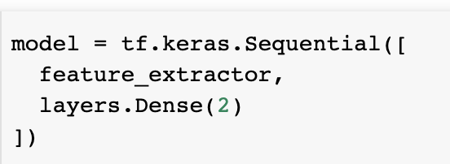
Using Mobilenet on cats vs dogs dataset
It is possible a call the pre-trained model complete without changing the last layer (output). When it is used with original output layer, it produces a probability set for the ImageNet dataset which has 1000 classes.
The networks variables (called as feature in the example) can be downloaded. Note, the size of the images in the ImageNet dataset is 224x224x3. So, we need to resize the cats vs dogs images. And, to freeze the variables we need to declare the .trainable=false parameter.
Finally, pre-trained variables can be used inside a sequential model with a dense layer of two neurons (cats or dogs?).

Slide 8
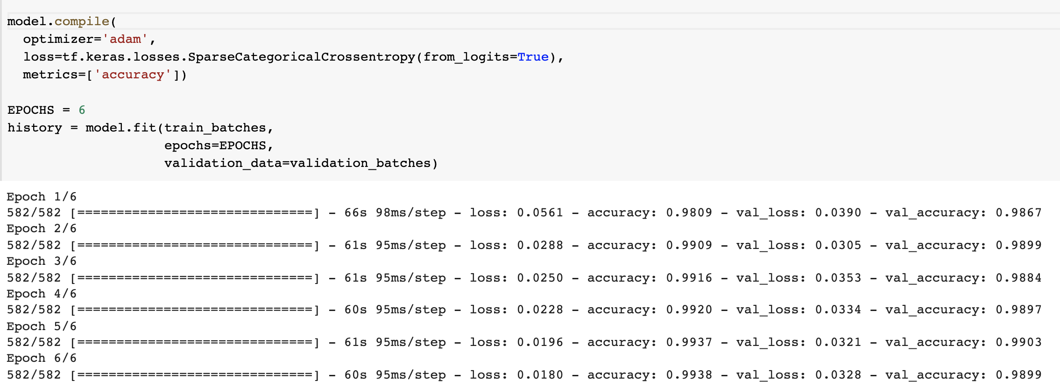
Using Mobilenet on cats vs dogs dataset
Remember, a simple network can only achieve ~70% accuracy and adding a couple of convoluted layer increased to ~80% on Cats vs Dogs validation dataset.
On the hand, using a pre-trained model increased the validation accuracy to ~98%. This

Slide 9
malware detection with pre-trained models
Classical malware detection approaches are unable to detect zero-day attacks or slightly deformed versions of known attacks since they onvestigate on the hash fingerprints (binary signatures) of the malware.
Other approaches include static and dynamic analysis, both of which have advantages and disadvantages.
Static analysis disassembles the code, but its performance can suffer because of the code obfuscation.
Dynamic analysis unpack the code and run it on a virtual environment, then analyze its behavior.

Slide 10
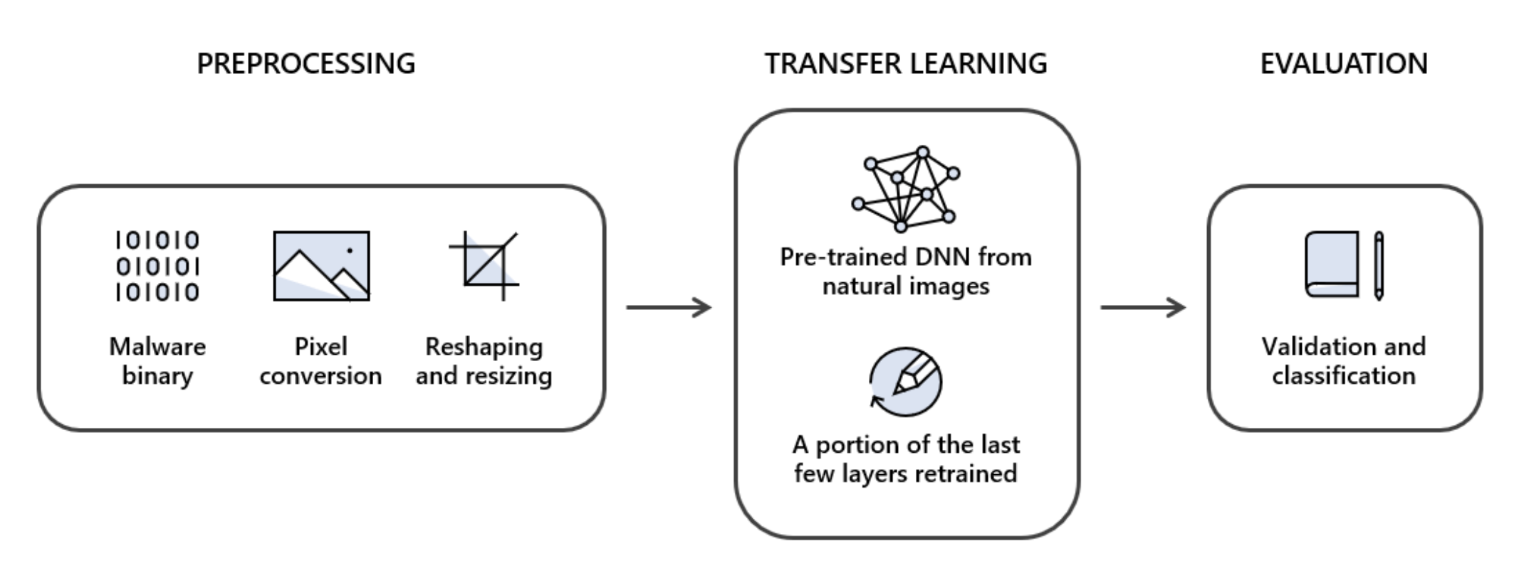
Using Transfer learning for malware detection
One common technique for malware detection is convert binary information to images and feed them to the trained networks. The image conversion step (preprocessing) consist of three sub-steps, respectively: pixel conversion, reshaping, and resizing.
Pixel conversion; every byte (01010011) is regarded as a pixel of range [0-255],
Reshaping; reshape the pixels stream into 2 dimensions,
Resizing; pre-trained models accept a fix-sized input (such as 224x224x3), so all images need to be resized.

Slide 11
Using Transfer learning for malware detection
One common technique for malware detection is convert binary information to images and feed them to the trained networks. The image conversion step (preprocessing) consist of three sub-steps, respectively: pixel conversion, reshaping, and resizing.
Pixel conversion; every byte (01010011) is regarded as a pixel of range [0-255],
Reshaping; reshape the pixels stream into 2 dimensions,
Resizing; pre-trained models accept a fix-sized input (such as 224x224x3), so all images need to be resized.

Slide 12
Transfer learning
There are relatively large malware datasets (and their corresponding converted image forms), but still small compared to ImageNet dataset. So, it is a good idea to use the models trained on the ImageNet dataset.
In the transfer learning part, we keep the pre-trained models’ weights and add a dense layer of two neurons since we have only malign (malware) and benign software binaries to classify.
We divide the malware data into three, respectively; training, validation, and test sets. After trained the network with 2 neuron-dense layer, testing set is used to evaluate the performance of the model.

